Slide 1
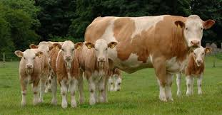
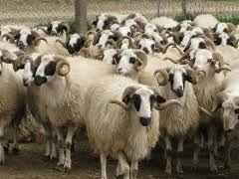
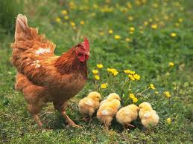
Agricultural Production Statistics Group
LIVESTOCK STATISTICS

Slide 2
Numbers of livestock:
These data are compiled by type, race and age group annually and directly from the Province Directorates of MoFAL through SDN.
Number of livestock and related data are obtained directly from the Province Directorates of MoFAL through Electronical Data Network (EDN) .
A livestock survey in line with EU requirements was carried out for the first time under the USST I Project in 2006.

Slide 3
Data Collection Method:
Statistical data on the number of livestock is collected annually by the Province and District Directorates of MoFAL through the SDN system.
Monthly data is compiled by TURKSTAT Regional Offices via questionnaire, phone and fax.
Livestock data is derived from multiple sources;
primarily from administrative records kept in the national animal identification and registration databases, namely,

Slide 4
Turkish Veterinary Information System (TurkVet) which was established under the EU-funded project titled “Support for Turkey’s Alignment to the EU Veterinary Acquis (TR 0203.05) for the registration of bovine animals and the control of their movements,
and the Sheep and Goat Registration System (SGRS) for ovine and caprine animals.

Slide 5
TURKVET
On 24 July 2006, implementation of TURKVET, a new software system supported by the EU, was initiated. This Registery System was established for purpose of registering bovine animals, sheep and goats through ear-tags and preparations regarding statistical information on number of animals kept and slaughtered, identification and registration of common pastures and summer grazing areas and registration of movements.

Slide 6
Besides, all slaughterhouses are aimed to be included in the system in order to ensure data flow. In this context, Turkstat has been working in an active collobration with MoFAL.
Compiled variables ;
Data related to Cattele, Buffalo, Sheep, Goat, Camel and Pig are compiled by age and types.

Slide 7
Annualy Data:
Data are compiled yearly by cooperation with MoFAL and data are controlled and analyzed by TurkStat and MoFAL staff.
Number of milked animals and the quantity of milk production,
Number of slaughtered animals (Calculated by Turkstat)
Number of poultry animals by type,
Apiculture,
Sericulture

Slide 8
Geographical Detail: The geographical coverage is whole Turkey.
Commodity and Service Detail: Annual data are available by district detail, monthly data are available by Turkey.
Revision Rule: Monthly data are temporary and revised if required when publishing the last month’s data. If revision on data occurs in the previous month , it has been revised while data has been published in the related next month.

Slide 10
THANK YOU for YOUR ATTENTION

